Slide 1

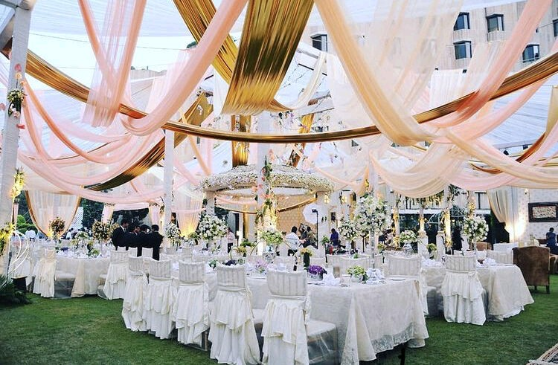
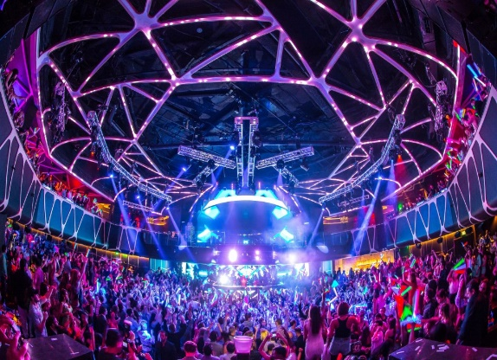
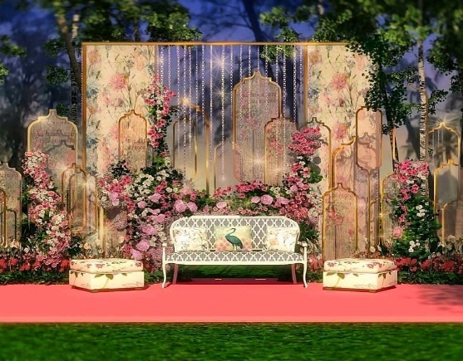
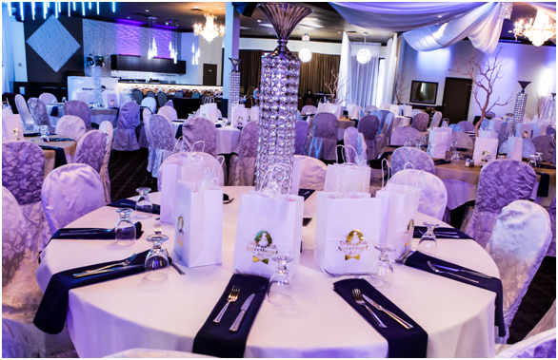
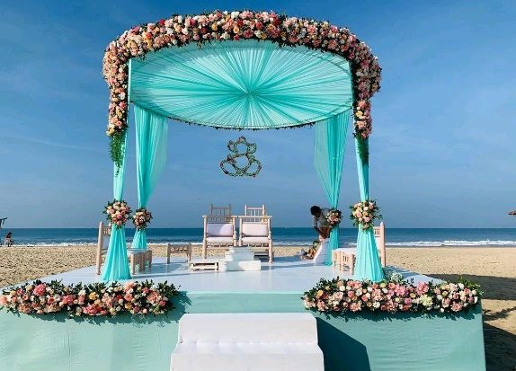
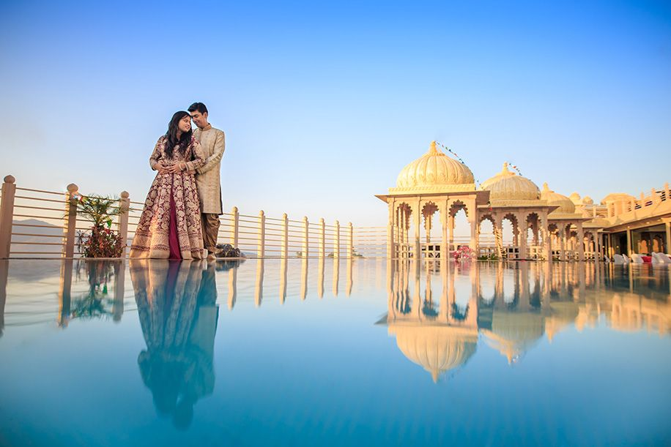
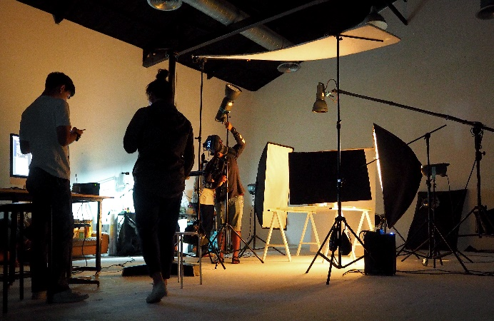
7 slide

Slide 2
Home
About
Our services
Portfolio
Artist Management
Sign up
Blogs
Contact
Our Company
Our Team
Female Actress
Male Actors
Event Management
Entertainment Management
Event Planner
Corporate
Decorations
Photography & Videography
Film Production
Female model
Male Model
Actor
Model
Child Artist
Pre-Production
Production
Post-Production
Female Child
Male Child
Name
City
Phone no
Email
Select Category
Address
Mail ID
Contact
Follow us social media (icon)
Chat on Whatsapp

